Slide 1

OData REST services in Java
with Apache Olingo™
Cologne, 12 December 2016

Slide 2
Introduction
Various integration mechanisms
REST architecture
OData overview
OData libraries for Java
Apache Olingo setup
First OData app

Slide 3

Introduction
Zurich’s Hackaton

Slide 4
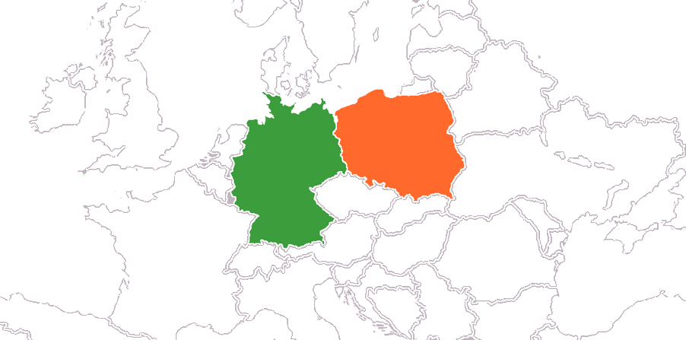
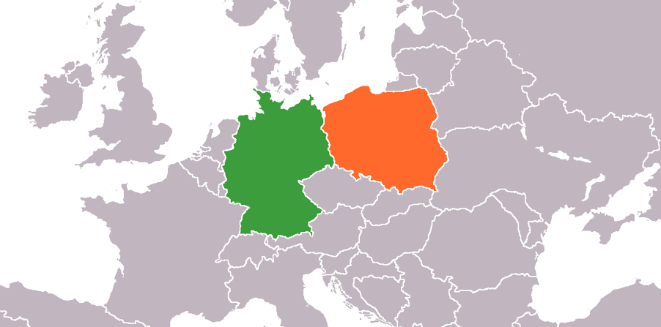

Introduction
Rome wasn't built in a day
~5 developers
+1000 Story Points
+1 year of development

Slide 5
Introduction
Various integration mechanisms
REST architecture
OData overview
OData libraries for Java
Apache Olingo setup
First OData app

Slide 6
Various integration mechanisms
RPC
Remote Procedure Call
Request-response message-passing system
Client calls a procedure on server
Server listens on a specific port
XML

Slide 7
Various integration mechanisms
SOAP
Simple Object Access Protocol
Successor of XML-RPC
XML and HTTP-based calls
Specifies exchange of information in the implementation of web services

Slide 8
Introduction
Various integration mechanisms
REST architecture
OData overview
OData libraries for Java
Apache Olingo setup
First OData app

Slide 9
REST architecture
REST
Representational State Transfer
Based on nouns and verbs come from all HTTP methods (GET, POST, PUT, DELETE)
  SOAP uses rather only HTTP POST
Not as restricted as SOAP – architecture, not a protocol
Stateless
JSON or XML

Slide 10

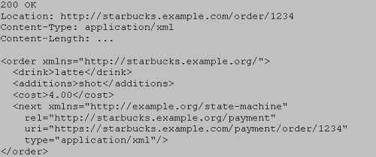

REST architecture
Evolution & constraints
WADL?
RAML?
HTTP/RPC
RESTful
HATEOAS
RSDL?
URI Resources
Verbs from HTTP
Stateless
Content Negotiation
Relations represented by Hypermedia
Verbs
URI Endpoints
Notes:
RAML – RESTful API Modeling Language bazuje na YAML-u
WADL – Web Application Description Language is a machine-readable XML description of HTTP-based web services. WADL is the REST equivalent of SOAP's Web Services Description Language (WSDL), which can also be used to describe REST web services.
RSDL – RESTful Service Description Language is a machine- and human-readable XML description of HTTP-based web applications (typically REST web services).
Unlike WADL, it concentrates on describing URIs as stand-alone entry points in to the application which can be invoked in different ways, does not require traversing over URI components to figure out URI structure, and supports URI/Headers/body parameters overloads. This makes it human-readable and easily consumed by both humans and machines.
HATEOAS – Hypermedia as the Engine of Application State, is a constraint of the REST application architecture that distinguishes it from most other network application architectures. The principle is that a client interacts with a network application entirely through hypermedia provided dynamically by application servers.

Slide 11
Introduction
Various integration mechanisms
REST architecture
OData overview
OData libraries for Java
Apache Olingo setup
First OData app

Slide 12
OData overview
Introduction by example – 1
accounts
ID
number
name
...
addresses
city
street
country
...
policies
ID
number
date
...

Slide 13

OData overview
Introduction by example – 2
root/api/policies/
/1/
/1
/account/
/addresses/
root/OData.svc/Policies('1')/Account/Addresses('1')
POST {}
DELETE
PUT {}
GET {}
GET [{},{}]
root/OData.svc/Policies?$filter=Account/Number eq 'abc12342' and year(Date) eq 2002 &$select=Number&$expand=Account($select=Name)&$format=JSON

Slide 14
OData overview
OData
Open Data Protocol
REST standarization
Started by Microsoft
Contract of the service – $metadata
Verbs in the URL (actions, functions)
No typical DTOs. Response object connected with the URL ($select, $expand, types casting)
Helper parameters ($top, $skip, $count)
Search mechanisms ($filter, $search)
Enums, complex types

Slide 15

OData overview
More info
http://docs.oasis-open.org/odata/odata/v4.0/errata03/ – official OASIS OData documentation
http://www.odata.org/ – main protocol page
http://services.odata.org/V4/OData/OData.svc/ – example OData 4 service
15 166 search results for „odata” at (23.11.2016).
12 919 in March, this year.

Slide 16
OData overview
Business perspective
Proper $filter implementation handles all future search requirements
  On our current project we were asked about a price of a „new” integration point for searching for partners with a given name and address: url/Account_Set?$filter=contains(AccountHolderContact/LastName, 'searched_name') and contains(AccountHolderContact/PrimaryAddress/AddressLine1, 'searched_address') and ZPartnerID ne null
Proper $batch implementation handles all possible mixes of saving operations
  On our current project we were asked to provide a mechanism for saving quotation. We had a mechanism for saving a draft and a mechanism for quoting. After implementing $batch functionality we were able to use those 2 mechanisms at once.

Slide 17
Introduction
Various integration mechanisms
REST architecture
OData overview
OData libraries for Java
Apache Olingo setup
First OData app

Slide 18
OData libraries for Java
Possibilities
Apache Olingo
SDL OData Frameworks
Odata4j
ODataJClient
Jello Framework
http://www.odata.org/libraries/
Notes:
V4 and rich features just in 2 first ones

Slide 19
OData libraries for Java
SDL OData Frameworks
Initial commits in Sep, 2015
Just OData v4
Support for both client and server
Annotation-based

Slide 20
OData libraries for Java
Apache Olingo
Started in 2014, OData v2
Support for both client and server
More examples, tutorials
Rich functionalities support, but still many to go

Slide 21
OData libraries for Java
Apache Olingo – more information
https://olingo.apache.org/doc/odata4/index.html – step by step tutorial with Apache Olingo
https://templth.wordpress.com/ – blog with some useful tutorials
https://github.com/apache/olingo-odata4 – official repository (ext, demo, tecsvc)
289 search results for „olingo” at (23.11.2016).
192 in March, this year.

Slide 22
Introduction
Various integration mechanisms
REST architecture
OData overview
OData libraries for Java
Apache Olingo setup
First OData app

Slide 23
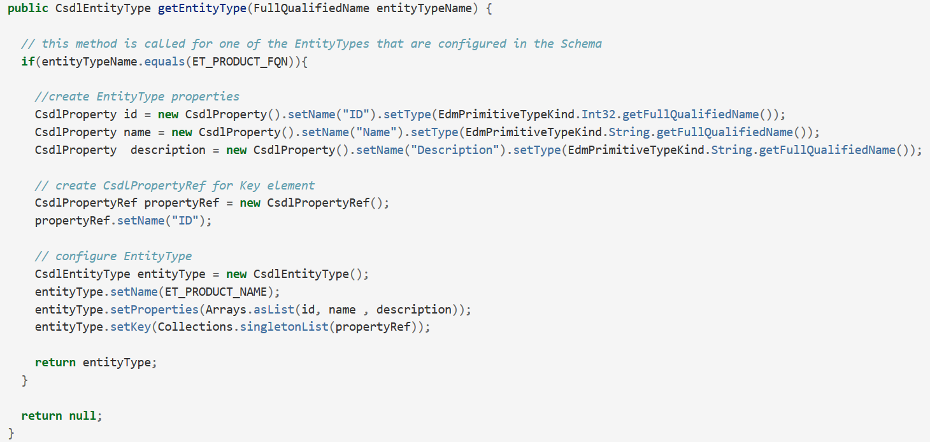
Apache Olingo setup
What we need to implement?
$metadata
http://services.odata.org/V4/OData/OData.svc/$metadata
http://localhost:8180/pc/service/odata.svc/$metadata
org.apache.olingo.commons.api.edm.provider.CsdlEdmProvider
getEnumType
getEntityType
getComplexType
getActions
getFunctions
getEntitySet
getActionImport
getFunctionImport
getEntityContainerInfo
getEntityContainer
getSingleton
getSchemas
getAnnotationsGroup
getTypeDefinition
getTerm
getAliasInfos

Slide 24
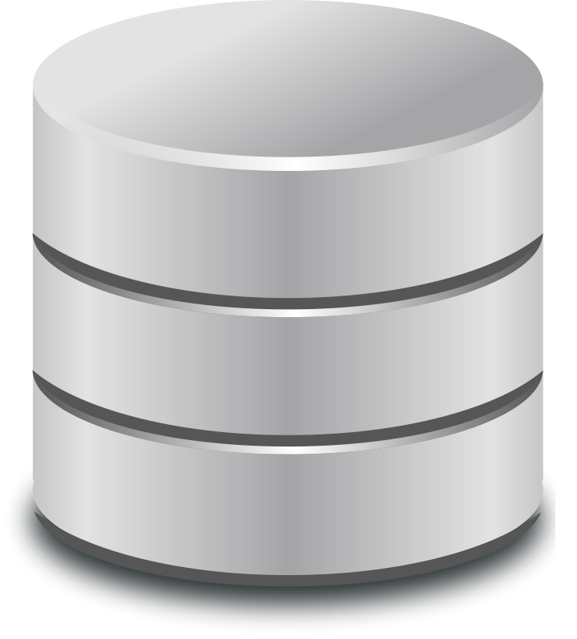
Apache Olingo setup
CsdlEdmProvider – how?
Builder with lot’s of reflections ☺
(path to XMLs)
XML whitelist
CsdlEdmProviderImpl
Annotation parser
CsdlEdmProviderImpl
(annotated)

Slide 25
Apache Olingo setup
From ServiceMetadata to Handler
odata = ((org.apache.olingo.server.api.OData) obj).newInstance()
serviceMetadata = odata.createServiceMetadata(CsdlEdmProvider, List<EdmxReference>)
//new ArrayList<EdmxReference>()
handler = odata.createHandler(serviceMetadata)

Slide 26
Apache Olingo setup
Processors
handler.register(processor)
ComplexProcessor
ComplexCollectionProcessor
PrimitiveProcessor
PrimitiveCollectionProcessor
ErrorProcessor
RedirectProcessor
RedirectProcessor
DeltaProcessor
ReferenceCollectionProcessor
ReferenceProcessor
ServiceDocumentProcessor
BatchProcessor
EntityProcessor
MediaEntityProcessor
MetadataProcessor
EntityCollectionProcessor
ActionPrimitiveProcessor
ActionComplexCollectionProcessor
ActionPrimitiveCollectionProcessor
ActionVoidProcessor
ActionEntityProcessor
ActionEntityCollectionProcessor
ActionComplexProcessor

Slide 27
Apache Olingo setup
$filter – ExpressionVisitor
visitBinaryOperator(BinaryOperatorKind operator, T left, T right)
visitUnaryOperator(UnaryOperatorKind operator, T operand)
visitMethodCall(MethodKind methodCall, List<T> parameters) visitLiteral(Literal literal)
visitMember(Member member)
visitAlias(String aliasName)
visitEnum(EdmEnumType type, List<String> enumValues)
visitTypeLiteral(EdmType type)
visitLambdaExpression(String lambdaFunction, String lambdaVariable, Expression expression)
visitLambdaReference(String variableName)

Slide 28
Apache Olingo setup
Handler in Servlet
javax.servlet.http.HttpServlet.service(HttpServletRequest, HttpServletResponse)
init()
this.handler.process(req, resp)
Spring?
  Spring Boot example
  Spring namespace for Olingo
  Playing with URLs – may be challenging ☺
Notes:
init() // should prepare oDataHandler

Slide 29
Introduction
Various integration mechanisms
REST architecture
OData overview
OData libraries for Java
Apache Olingo setup
First OData app

Slide 30
Apache Olingo setup
App repository
Snapgram – Yet another images uploading
User with many Images (incl. private ones)
Each Image belongs to Category
Searching ($filter) for Images
https://github.com/sollersconsulting/jugc

